Slide 1
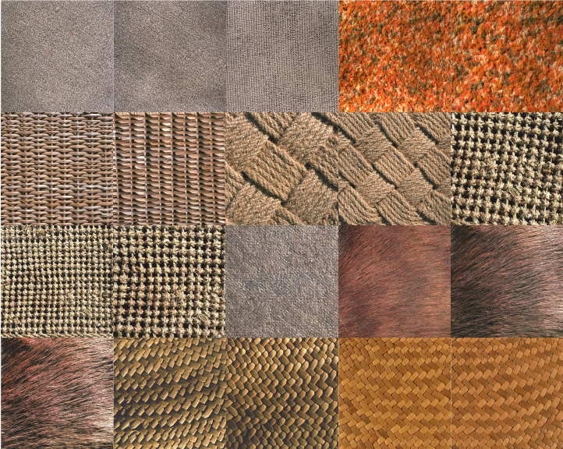
Texture Defect Detection Using
FCM- GA
Atefe Toobak

Slide 2
Outline
Motivation and Goals
History
Introduction to Database
The Proposed Algorithm
Experimental Results
Conclusions and Future Works

Slide 3
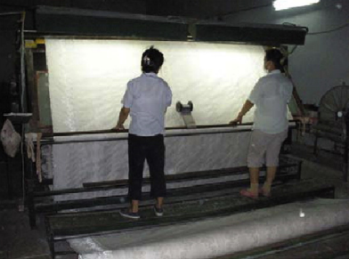
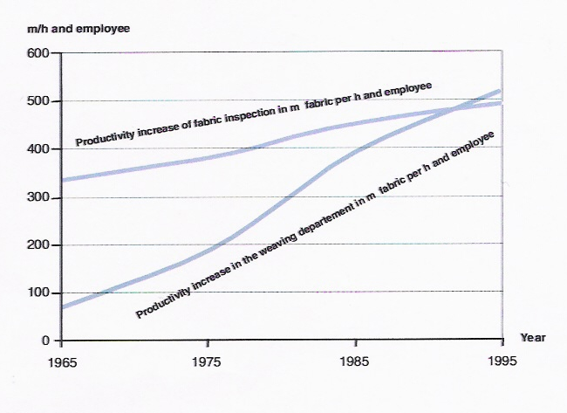
Motivation and Goals

Slide 4
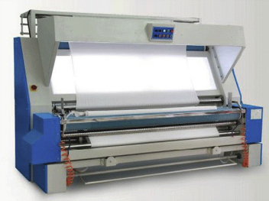
Motivation and Goals

Slide 5
History
Methods of Texture defect detection
Statistical approach
Spectral approach
Model-based approach
Hybrid approach
Fourier Transform
Wavelet transform
Gabor Transform
Markov Random field
Fractal
Auto-correlation function
Co- occurrence Matrix
Local binary pattern
Two categories :
Increase the range of defects to be defects
Increase detection speed

Slide 6
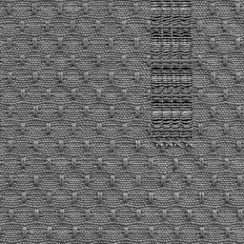
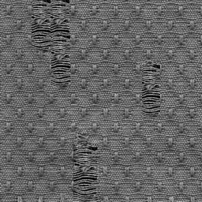
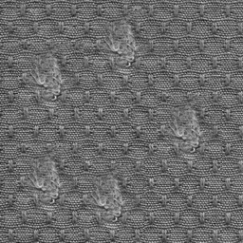
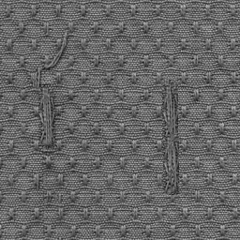
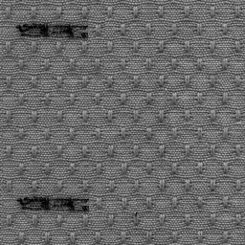
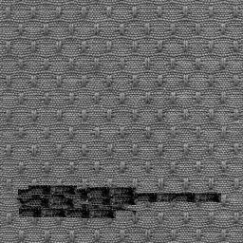
Database
Dot-patterned fabric
Industrial Automation Research Laboratory
Dept. of Electrical and Electronic Engineering,
The University of Hong Kong
Researchers: H.Y.T. Ngan, G.K.H. Pang
Built in 13 Aug,2003
Broken End
Hole
Knots
30 defective samples (6 groups )
30 non-defective samples
scanned with 200dpi
256x256 in gray level scale
Netting Multiple
dirty yarn
oil stain

Slide 7
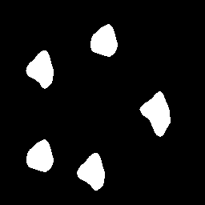
Proposed Algorithm
256x256
Defective Images
Wavelet
Transformation
Approximation
Details
Histogram
GA- FCM
Segmented defect

Slide 8
Proposed Algorithm
256x256
Defective Images
Wavelet
Transformation
Approximation
Details
Histogram
GA- FCM
Segmented defect

Slide 9
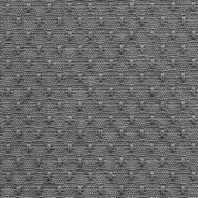
Wavelet Transformation

Slide 10
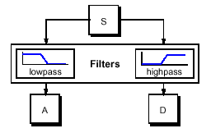
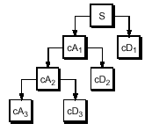
Wavelet Transformation
Multiresolution Signal Representation

Slide 11
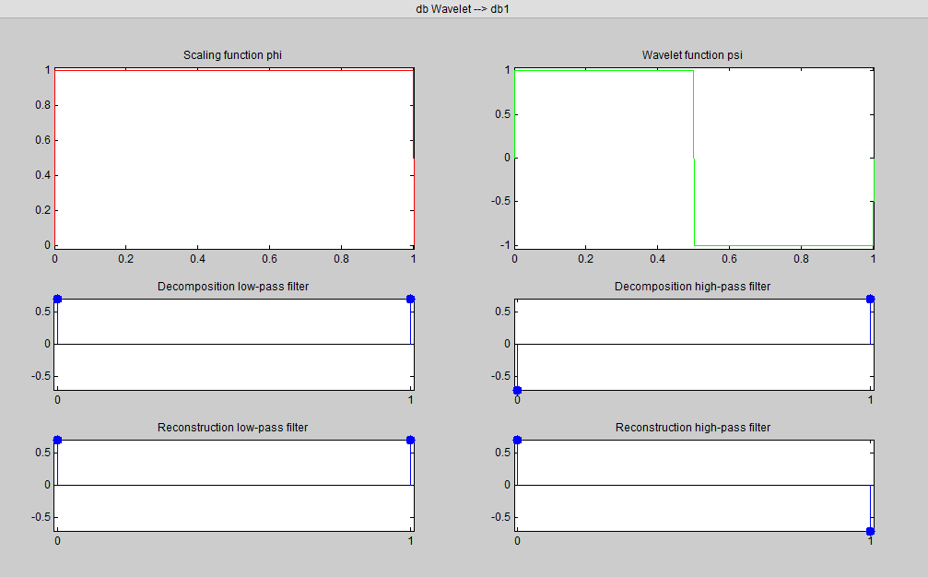
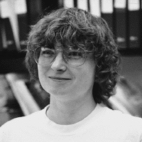
Wavelet Transformation
Daubechies, 1988

Slide 12
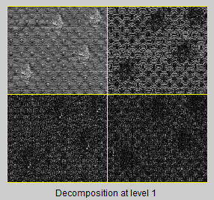
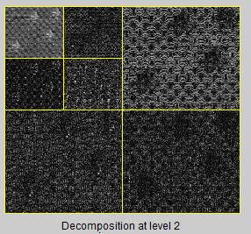
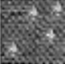
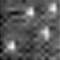

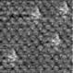
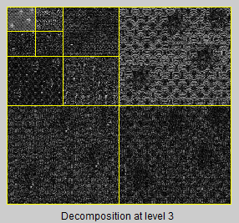
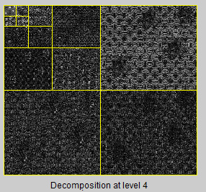
Wavelet Transformation
Bilinear
interpolation

Slide 13
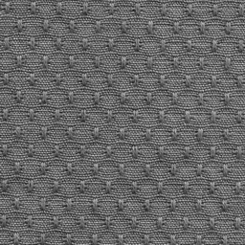
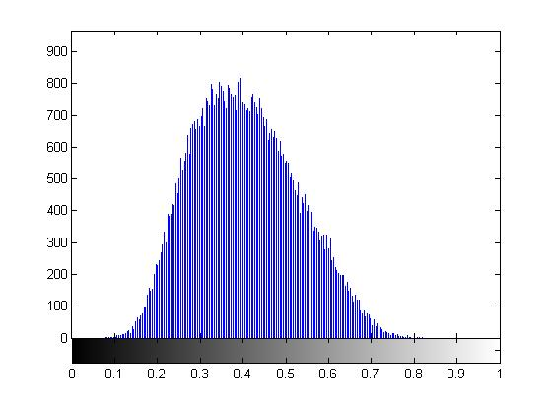
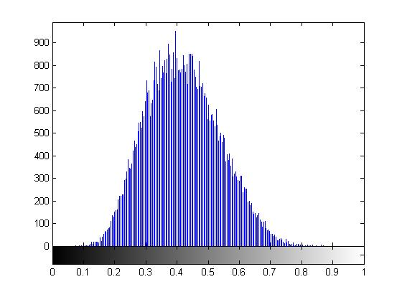
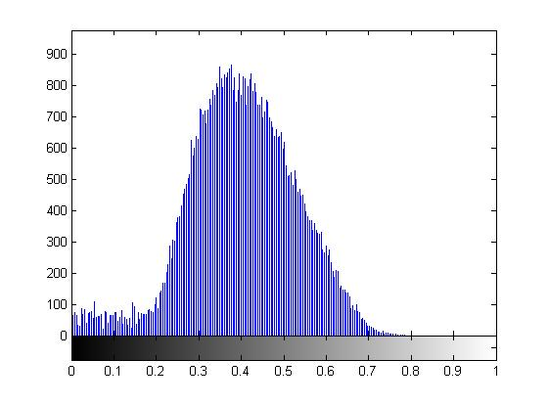
Resolution Level Selection
N= 4
N= 2

Slide 14
256x256
Defective Images
Wavelet
Transformation
Approximation
Details
Histogram
GA- FCM
Segmented defect

Slide 15
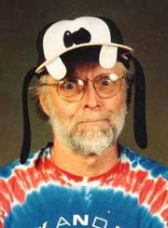
Fuzzy C-Means Clustering
Prof. Bezdek, 1981

Slide 16

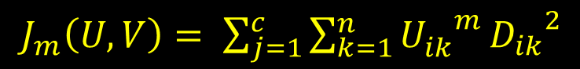
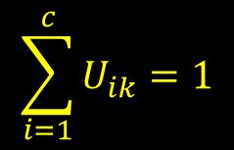
Fuzzy C-Means Clustering
FCM
U
objective function
$J_{m}\left(U,V\right)= \sum_{j=1}^{c}{\sum_{k=1}^{n}{{U_{ik}^{}}^{m}}}{D_{ik}}^{2}$
Distance
$$D_{ik}=\left\|x_{k} − V_{i}\right\|$$
Constraint
$$\sum_{i=1}^{c}{U_{ik}}=1$$

Slide 17
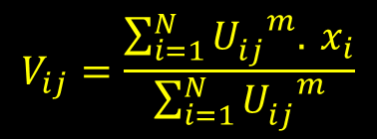

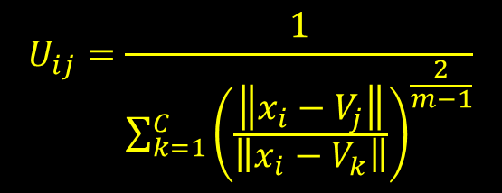
Fuzzy C-Means Clustering
S=0
Initialize U matrix randomly
$$V_{ij}=\frac{\sum_{i=1}^{N}{{U_{ij}^{}}^{m}. }x_{i}}{\sum_{i=1}^{N}{{U_{ij}^{}}^{m}}}$$
Calculate Center cluster(V)
Update U matrix
$$U_{ij}=\frac{1}{\sum_{k=1}^{C}{{\left(\frac{\left\|x_{i}−V_{j}\right\|}{\left\|x_{i}−V_{k}\right\|}\right)}^{\frac{2}{m−1}}}}$$
No
$\left\|U_{s+1}−U_{s} \right\|$ <$ε$
S=S+1
Yes
Iteration is terminated

Slide 18
Fuzzy C-Means Clustering
Advantages
Unsupervised
Always converges
Disadvantages
Long computational time
Sensitivity to the initial guess (local minima)
Sensitivity to noise

Slide 19
FCM
GA
Initialize V matrix randomly
selection
Calculate U matrix
crossover
mutation
Update Center Cluster
Calculate cost function J _{fcm}
Compute fitness
Fitness = J _{fcm}
If
J _{fcm} < 0.01
if
fitness _{child} < fitness _{parent}
No
No
Yes
Yes
Optimum Center Cluster
New _{population} = Child

Slide 20


GA-FCM
Optimum Center Cluster
Calculate u matrix
0
1
$$U$$
$$min\left\{\left|U_{ij} −0.5\right|\right\}$$
0.5
50 % chance for defective cluster
Best Threshold
50 % chance for non defective cluster

Slide 21
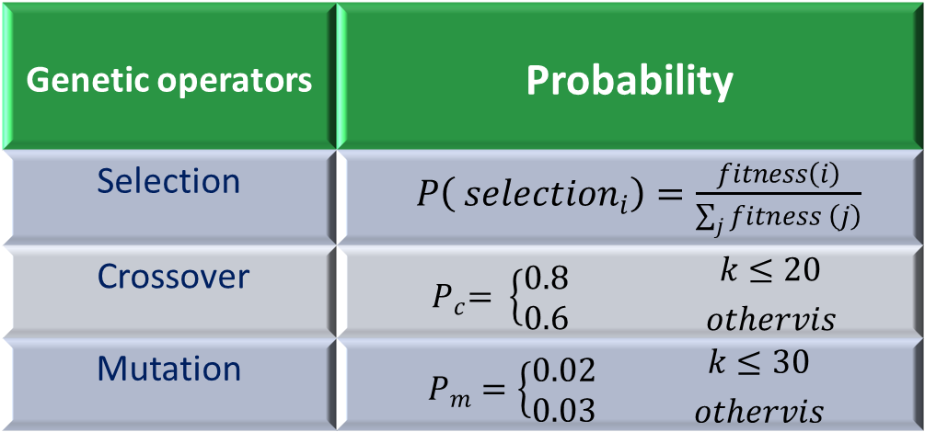
GA-FCM
Genetic operators | Probability
Selection | $P\left( {selection}_{i}\right)=\frac{fitness\left(i\right)}{\sum_{j}{fitness \left(j\right)}}$
Crossover | $${ P}_{c}= \left\{\begin{aligned}0.8 \\ 0.6\end{aligned}\right. {k≤20 \atop othervis}$$
Mutation | $$P_{m}=\left\{\begin{aligned}0.02 \\ 0.03\end{aligned}\right. {k≤30 \atop othervis}$$
K= 200

Slide 22
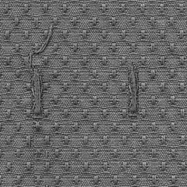
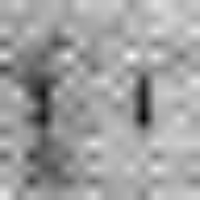
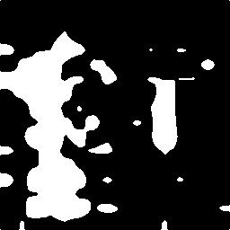
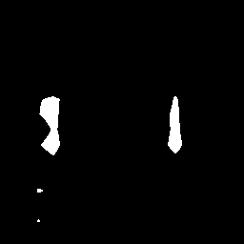
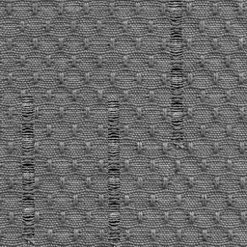
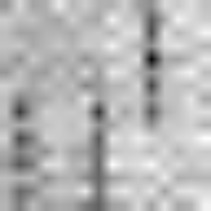

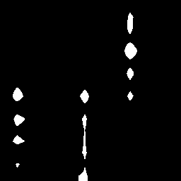
FCM vs. GA-FCM
Defective Image
Wavelet (App)
FCM
GA-FCM

Slide 23
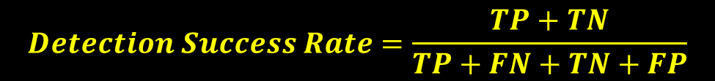
Performance Comparison
Defect detection accuracy
Computational complexity and speed
$$Detection Success Rate=\frac{TP+TN}{TP+FN+TN+FP}$$
TP: True Positive
TN: True Negative
FP: False Positive
FN: False Negative

Slide 24
Experimental Result
Dot Patterned fabrics

Slide 25
Experimental Result
Unpattern fabrics

Slide 26
Nep
Experimental Result
Thick Region
Thin Region
Non-Woven fabrics

Slide 27
Algorithm | Defect Type |  |  |  |  |  | Average detection rate
 | (a) | (b) | (c) | (d) | (e) | (f)
Henry Ngan and et al | 96 | 97 | 94 | 95 | 95 | 94 | 95.1
Proposed Method | 100 | 100 | 94 | 95 | 100 | 100 | 98.1
Experimental Result
(a) Broken End (b) Hole
(c) Knots (d) Netting Multiple
(e) dirty yarn (f) oil stain

Slide 28
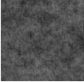
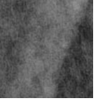
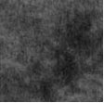
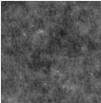
Nonwoven fabric
30 defective samples (3 groups )
30 non-defective samples
scanned with 300dpi
Experimental Result
(a) Thick Region (b) Thin Region (c) nep
Algorithm | Defect Type |  |  | Average detection rate
 | (a) | (b) | (c)
Proposed Method | 100 | 100 | 80 | 93.3

Slide 29
Conclusion
Result show that proposed method has an acceptable detection rate (more than 98%) in all kinds of type defect.
The computational complexity of proposed method is low and it can use for online defect detection.
GA-FCM method is effective for selecting threshold values in segmentation problem.

Slide 30
Texture Segmentation
Brodatz Album Samples

Slide 31
Texture Segmentation
Test Samples
Proposed
method
Proposed
method
+ Entropy

Slide 32
MRI Brain segmentation
Original Image
FCM
GA-FCM

Slide 33
List of papers
A.Toobak, O. R. Marouzi, M. Latifi, “A Fuzzy Approach for Automatic Fabric Defect Detection “International Journal of Computer Networks & Communications (IJCNC),2012
A.Toobak, O. R. Marouzi, “A Fuzzy-Genetic Approach for MRI Brain Segmentation” IEEE ICCSCE ,2012

Slide 34
Thanks for your attention

